Slide 1
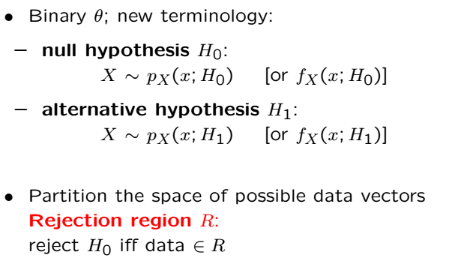
Binary Hypothesis Testing
Unlike Bayesian case, there is no prior distribution on parameter
Null hyp. is “status quo”, Alternative hyp.: “something new”
E.g., testing effectiveness of a drug; initially presume ineffective

Slide 2
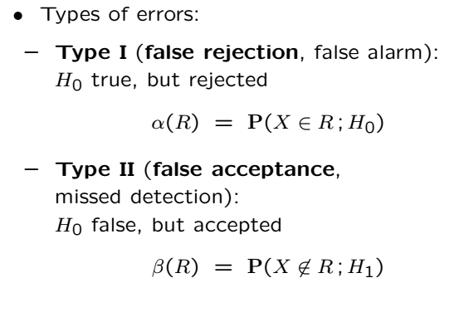
Type I and Type II Errors
Type I probability is AKA, “false alarm prob.”, or “significance level”

Slide 3

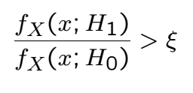
Likelihood Ratio Test
How to identify the rejection region?
Accept if the “likelihood ratio” is “large enough”
Threshold trades off Type I and Type II errors
Often, thresholding the likelihood ratio is same as thresholding
a function of the observations

Slide 4
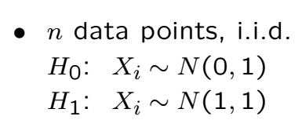
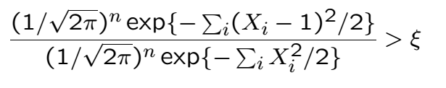

Example (Testing Mean)
Finding the relationship betw the two thresholds not crucial
What is important is that, the sum needs to be “large enough”

Slide 5
Example (Cont’)

Slide 6
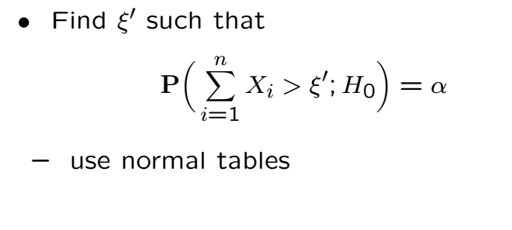

How to find Threshold
Pick, threshold to get a tolerable false alarm prob.
is typically small (e.g., )
Let us now find the threshold on the sum to get

Slide 7
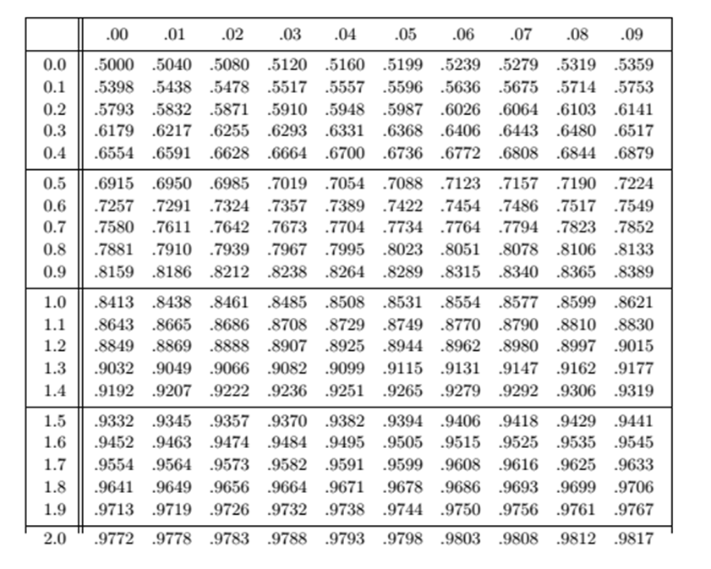
Apply CLT

Slide 8
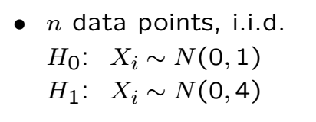
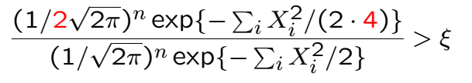

Example (Testing Variance)

Slide 9
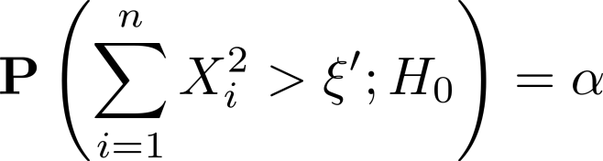
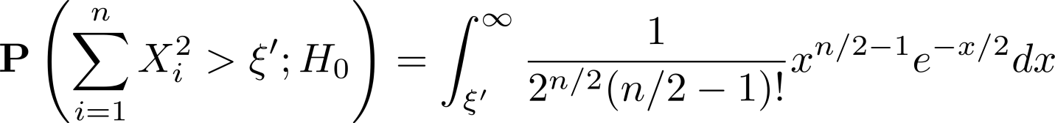
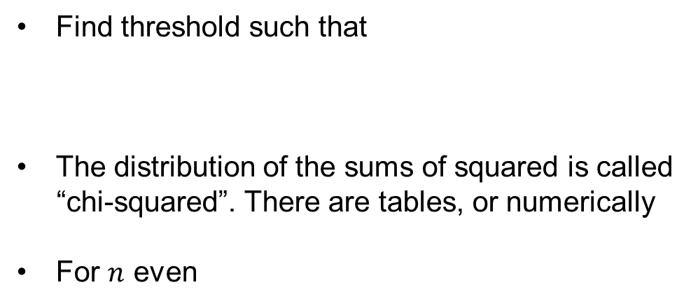
How to Find Threshold
Find threshold such that
The distribution of the sums of squared is called
“chi-squared”. There are tables, or numerically
For $n$ even

Slide 11
Acknowledgements and Citations
Parts of these slides are adapted from the following resources:
Power Point Lecture Slides for the Textbook http://bcs.wiley.com/hebcs/Books?action=index&bcsId=8676&itemId=1118324560
John Tsitsiklis. 6.041 Probabilistic Systems Analysis and Applied Probability, Fall 2010. (Massachusetts Institute of Technology: MIT OpenCourseWare),http://ocw.mit.edu (Accessed 13 Apr, 2015). License: Creative Commons BY-NC-SA

